Slide 1
Strategies for Microsoft’s Film Studio
Tracy Strickel

Slide 2
Initial Data Cleaning
Removed all films made before 2000
Removed all films that were not represented in both the IMDB databases and the Budget database
Removed all films that had a production budget less than $100,000 (very few)

Slide 3
“Success Score”
Question: how much does past success from a producer, director, actor, or writer impact the success of a film?
Iterated through IMDB persons databases to extract only producers and actors. Extracted directors and writers from individual databases.
Used this data in conjunction with budget database to map films to the humans who worked on them
Created a list of “successful” people who have worked on top-250 successful films since 2000
Created individual scores by job category, counting the number of successful films for each individual, resulting in a combined net “success score” for each film

Slide 4
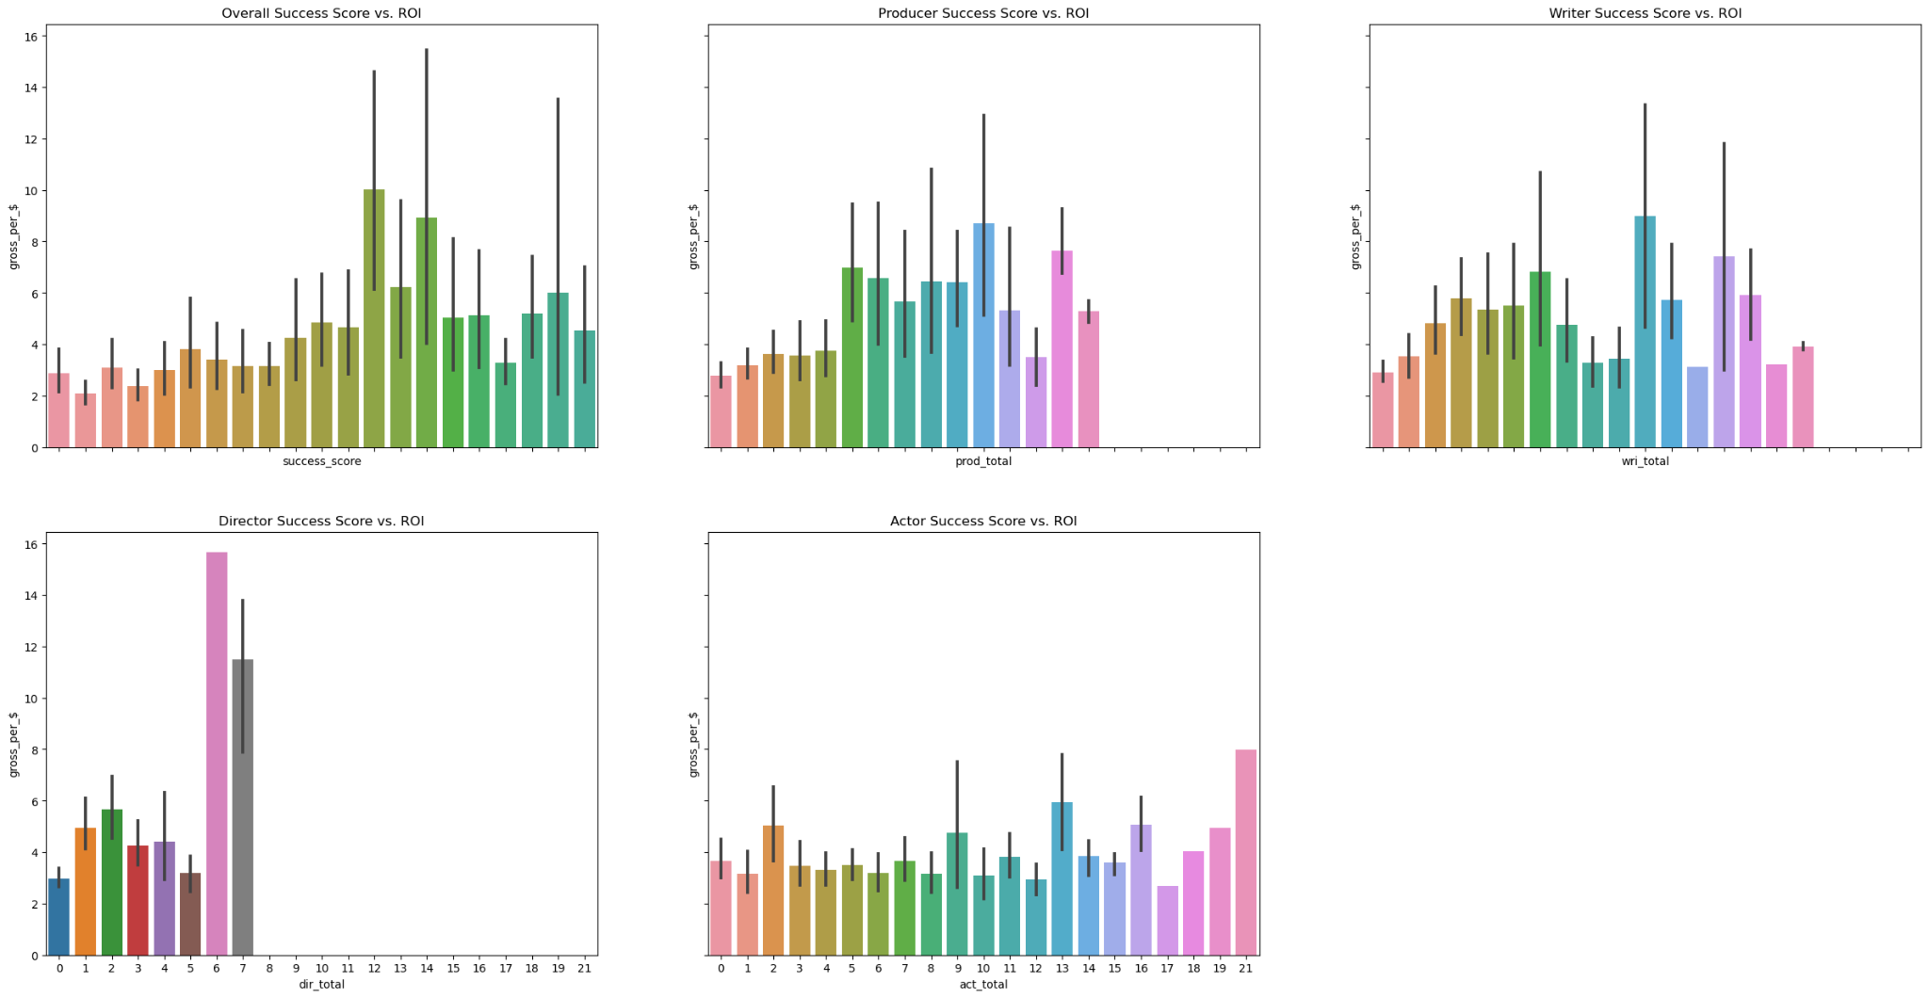
Impact of success on return ratio, all genres

Slide 5
Exploring statistics by genre
 | Correlation Budget/Gross | Budget Mean | Worldwide Gross Mean | Success Score Mean | Correlation Success/Gross | Return on Investment Mean
Horror | 0.44 | 1.837 x 10^7 | 7.62 x 10^7 | 4.68 | 0.68 | 8.16
Doc. | 0.49 | 0.438 x 10^7 | 1.39 x 10^7 | 0.57 | 0.37 | 4.41
Anim. | 0.58 | 9.68 x 10^7 | 35.49 x 10^7 | 13.57 | 0.56 | 4.13
Sci-Fi | 0.75 | 8.39 x 10^7 | 37.08 x 10^7 | 13.72 | 0.73 | 3.89
Musical | 0.53 | 2.09 x 10^7 | 15.35 x 10^7 | 3.95 | 0.51 | 3.42
Looking with films with high ROI mean or low budget/gross correlation
Want cheap films that consistently make money

Slide 6
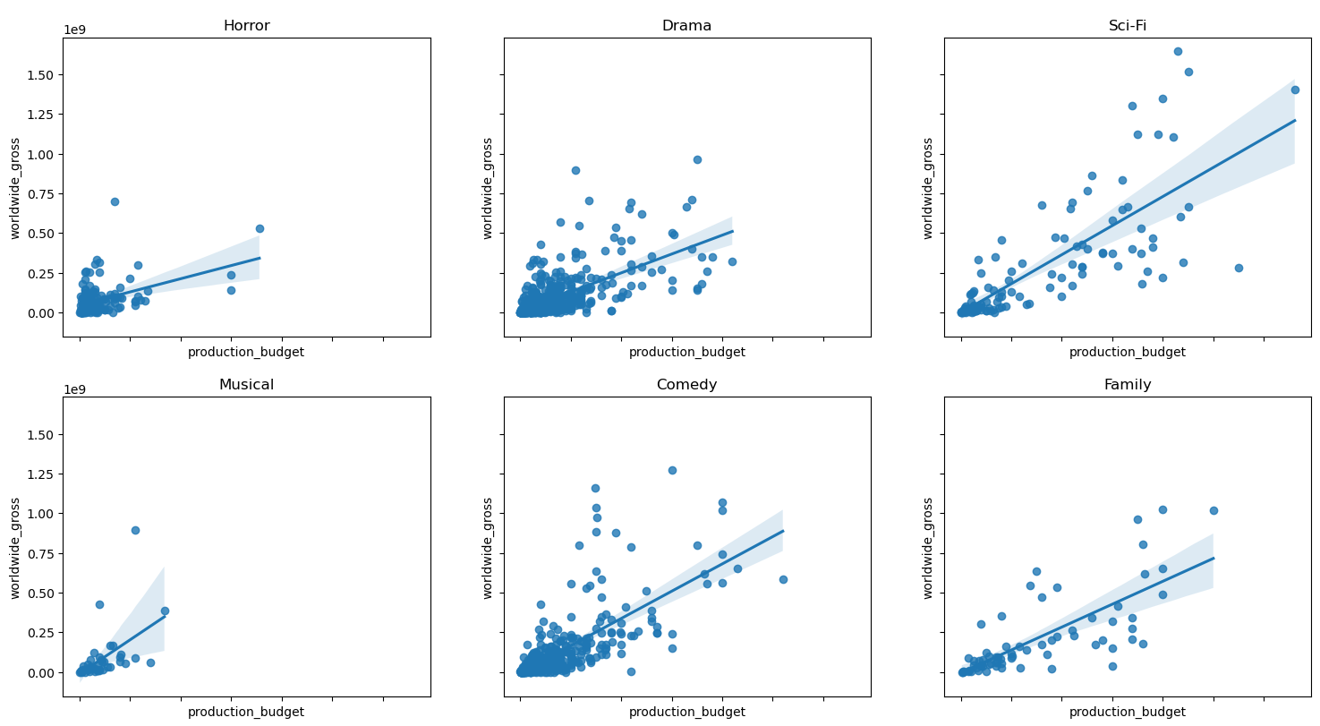
Distributions of budget vs. worldwide gross for selected genres

Slide 7
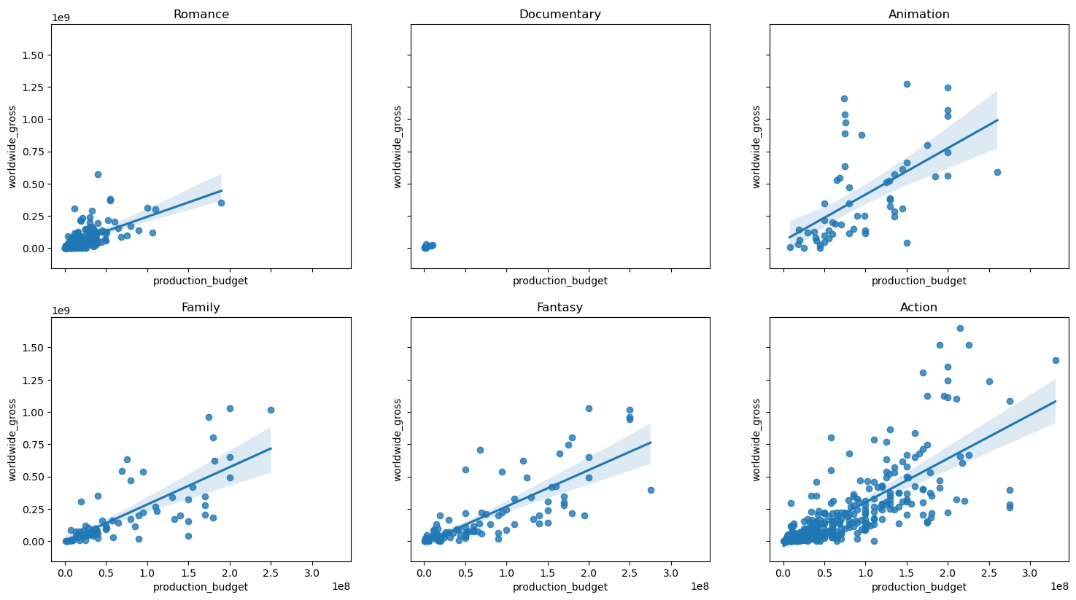
Distributions of budget vs. worldwide gross for selected genres
Animation looks best - the linear regression line has a high starting y-value, which means it is less likely to flop, and there are many high outliers in the low-medium budget range

Slide 8
Why not horror?
Overall ROI statistics are shifted higher by two extreme outliers and approximately ten high outliers
These films are clustered in the early to mid 2010s and represent a small minority of datapoints. Eleven of the top 20 horror films are from the same production company - this firm specializes in horror and was very successful at capturing the market during a trendy time for the genre.
Removing the ten highest grossing films from horror reduces the ROI mean from 8.16 to 5.24 - much closer to Documentary at 4.41 but with a much less saturated market

Slide 9
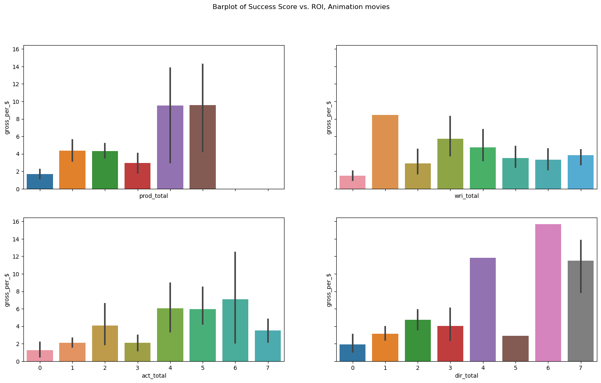
Should Microsoft hire previously successful people to make their animation films?
Producers and directors have outsized impact
There is some benefit to hiring established actors
Little impact from writers
Microsoft should hire established producers and directors

Slide 10
Should Microsoft hire previously successful people to make their documentaries?
Few documentaries in dataset, chosen for examination because they were proportionately very successful compared to budget
Only two documentaries present in the dataset had cast or crew members that were associated with top 250 films, and each had very few credits
From the data provided, we can assume Microsoft does not need to hire previously successful documentarians, since there are successful documentaries present that had no previously successful individuals credited.

Slide 11
Recommendations!
Microsoft should make low to moderate budget films, since the ROI of higher budget film plateaus across genres.
Microsoft should focus on animation movies. Animation is the most consistent high performer at low to moderate budgets and animation movies are less likely to flop.
Their animation studio should recruit experienced directors and producers
They should spend a proportionately small amount of money creating micro-budget documentaries, which are undersaturated in the dataset and don’t need established cast and crew to perform well. The potential benefits of capturing this market are worth the money invested. Documentaries have a good ROI, so the amount lost can be expected to be low.

